Slide 1
Salesforce Data Testing
Ankita Mohapatra- amohapatra@deloitte.com

Slide 2
Contents
What is Data Migration Testing 3
Need for Data Migration Testing 4
Pre-Migration Testing 5
Migration Testing 6
Post Migration Testing 7
Testing Methodology for Data Migrations 8
Functional Testing Areas to consider for Data Migrations 9
Unit/System Testing 9
Functional/Integration & E2E Testing 10
User Acceptance Testing 11
Production Validation 12
Salesforce Data Loading Tools & Demo 13
Salesforce Data Loader (Demo) 15
Data Import Wizard (Demo) 16
Data Loader vs Import Wizard 17
Salesforce Workbench (Demo) 18
Best Practices - Salesforce Data Migration 19

Slide 3
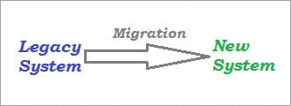
What is Data Migration Testing
Migration Testing is a verification process of migration of the legacy system to the new system with minimal disruption/downtime, with data integrity and no loss of data, while ensuring that all the specified functional and non-functional aspects of the application are met post-migration.
As we know, the application migration to a new system could be for various reasons, system consolidation, obsolete technology, optimization or any other reasons.
Key points to Remember:
Any kind of disruption/inconvenience caused to the user due to migration needs to be avoided/minimized. Eg: downtime, loss of data
Need to ensure if the user can continue to use all the features of the software by causing minimal or no damage during migration. Eg: change in the functionality, removal of a particular functionality
It is also important to anticipate and rule out, all the possible glitches/hindrances that might occur during the actual migration of the live system.

Slide 4
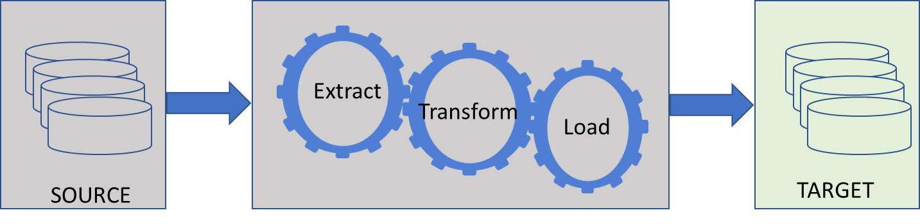
Need for Data Migration Testing
Data migration is a challenging and time-consuming task that demands ample planning along with a good understanding of the previous system.
Poor data mapping can lead to the eventual loss of important data and critical functionality.
There are two major things to be considered during data migration: data volume and data value.
The different phases of Migration test to be carried out at the Test Lab can be classified as below.
Pre-Migration Testing
Migration Testing
Post Migration Testing
Organizations with Salesforce CRM normally face large and complex data migrations.
Testing is a key phase to uncover issues beforehand.
To mitigate the risks such as data corruption, missing data, loss of data .
Mitigate application performance issues involved in data migration .

Slide 5
Phase#1 - Pre Migration Testing
Before migrating the data, set of testing activities are performed as a part of Pre-Migration test phase. This is ignored or not considered in simpler applications. But when complex applications are to be migrated, the Pre-Migration activities are a must .
Below is the list of actions that are taken up during this phase:
Set a clear scope of the data
Higher level mapping.
Lower level mapping.
Study the new application’s data schema
A number of tables in the legacy system are to be noted down.
A number of records in each table, views should be noted in the legacy application.
Study the interfaces in the new application and their connections
Prepare test cases, test scenarios, and use cases for new conditions in the new applications.
Execute a set of test cases, scenarios with a set of users and keep the results, logs stored.
Count of the data and records should be noted down clearly.

Slide 6
Phase#2 - Migration Testing
Verifying the documentation part of ‘Migration Guide’ is also a part of data Migration Testing. Verify if the document is clear and easy to follow. All the scripts and steps must be documented correctly without any ambiguity. Any kind of documentation errors, miss matches in the order of execution of steps also need to be considered important so that they can be reported and fixed.
‘Time taken to migrate the system’ needs to be recorded in the final test report
It is necessary to note the ‘Downtime’ required for Migration test.
Migration Activity Includes:
Actual Migration of the application
Firewalls, port, hosts, hardware, software configurations are all modified as per the new system on which the legacy is being migrated
Data leaks, security checks are performed
Connectivity between all the components of application is checked
Once the Migration activity specified in the guide is completed, all the servers are brought up and basic tests related to verification of successful migration will be done, which ensures that all the end to end systems are appropriately connected and all the components are talking to each other, DB is up and running, front end is communicating with the back end successfully.

Slide 7
Phase#3 – Post Migration Testing
Once the application is migrated successfully, Post-Migration testing comes into the picture. Here end-to-end system testing is performed in the testing environment. Testers execute identified test cases, test scenarios, use cases with legacy data as well as a new set of data.
In addition to these, there are specific items to be verified in the migrated environments which are documented as a test case and included in the ‘Test Specification’ document.
Some of them are noted as below :
Check whether all the data in the legacy is migrated to the new application within the downtime that was planned.
Compare data values between legacy and new application’s database.
Test the migrated data against the new application.
Check and ensure that the earlier supported functionality in the legacy system works as expected in the new system.
Check for data mismatch cases like data type changed, storing format is changed etc.,
Check for legacy data’s redundancy.
Verify the users from the legacy system can continue to use both the old functionality and new functionality, especially the ones where the changes are involved.
Carry out functionality related tests with a variety of data samples.
Verify that the software upgrade has not opened up any security vulnerabilities and hence carry out security testing.

Slide 8
Testing Methodology for Data Migrations
A common approach to testing data and content migrations relies upon data sampling, where some subset of random data or content is selected and inspected to ensure the migration was completed “as designed”.
Those that have tested migrations using this approach are familiar with the typical iterative test, debug and retest method, where subsequent executions of the testing process reveal different error conditions as new samples are reviewed.
This process works but is reliant upon an acceptable level of error and an assumption pertaining to repeatability.
Normally we will focus on repeatability and perform three or more iterations of testing and data loads until the client can confirm that we have achieved a reasonable sample .

Slide 9
Functional Testing areas to Consider
Unit/System Testing:
Security Model Review: Validate that users have been added to the appropriate profiles with the necessary role(s), sharing rules and field level security.
Object/Field Level Validation: Validate that all objects and fields have been correctly setup for the data loading to begin.
Run small loads of accounts, contacts, leads, products opportunities, etc into stage to be sure the objects, fields and data mapping has been implemented correctly before we run large data loads.
Load Count Validation: Validate that exported record counts equal imported record counts
If 50,000 contacts were exported from the legacy system we should have 50,000 contacts added to SFDC (subtract duplicates). The data load team can provide this information. Reports can also be created for this validation.
Error Handling Review: Validate that any errors during the migration are identified, investigated, and their disposition agreed. – Business Users May be Required.
Ensure adequate (verbose) Error Logging supports error investigation
Errors can be Informational (This is what happened but no need to worry)
Warning (these warning messages were generated)
Fail (the data failed to migrate)

Slide 10
Functional Testing areas to Consider(contd.)
Functional/Integration Testing:
Data Integrity Validation: Validate that contacts and opportunities have been associated with the correct accounts.
Validate that that all duplicates and invalid data have been eliminated.
Workflow Validation: Validate that all new workflow, assignment, approval rules and email notifications are working correctly.
ETL Load Validation: Validate that the information within the new ETL feeds is able to be loaded correctly into Salesforce.com.
This includes field level validation to be sure data is not truncated and all data types align.
Need to evaluate the full cycle of data between the systems to be sure duplicates are not created on subsequent cycles. This is the Add, Update and Delete scenarios that can occur in either system.
End to End Testing:
ETL System Load Validation: Validate that the entire process for loading of the ongoing feeds and keeping all data in sync between the “external systems” to SFDC is working correctly.

Slide 11
Functional Testing areas to Consider(contd.)
User Acceptance Testing:
UAT Security Validation: Business to validate that all users have been added to the appropriate profiles with the necessary role(s), sharing rules and field level security.
UAT Functional Validation: Business users from Sales and Marketing to log into the testing environment to validate that all of their accounts and contacts are now in SFDC.
This includes validation of account, contacts, products, pricing, contracts, subscription history, mail templates, custom reports, etc.
UAT Quality Validation: Business users to validate that no duplicates and only valid data has been migrated to Salesforce.com. User acceptance testing provides an opportunity for the user community to interact with legacy data in the destination system prior to production release, and most often, this is the first such opportunity for the users. Attention should be given to reporting, downstream feeds, and other system processes that rely on migrated data.

Slide 12
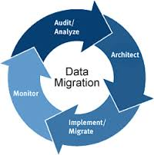
Functional Testing areas to Consider(contd.)
Production Validation:
Production Go-Live Validation: Final validation in production to verify that all configuration was and data-loads were deployed successfully. All of the testing completed prior to the production migration does not guarantee that the production process will be completed without error.

Slide 13
Salesforce Data Loading Tools

Slide 14
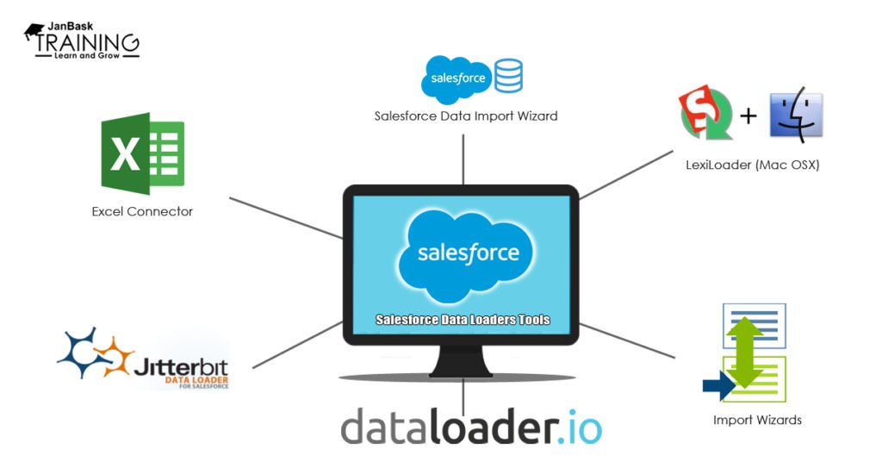
Salesforce Data Loading Tools
Today, Salesforce has become one of the most popular CRM systems used by organizations. In order to use Salesforce, one must know how to feed in and take out data from the Salesforce efficiently. There are certain applications that can help Salesforce Administrators and Developers in this activity. Salesforce data loader applications can provide many ways to upload and export data.
Let us look at some of the commonly used Data Loader tools/apps today -

Slide 15
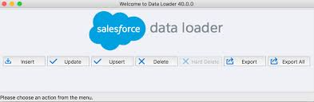
a) Salesforce Data Loader
Client Application used for bulk import or export of data.
Used to insert, update, delete or export Salesforce records.
When importing data , data Loader reads, extracts and loads data from comma separated values (CSV) Files or a DB connection.
When exporting data, it outputs CSV files.
By using Salesforce data loader you can load up to 5,000,000 records.
Sample data load using Data Loader to be shown (demo)

Slide 16
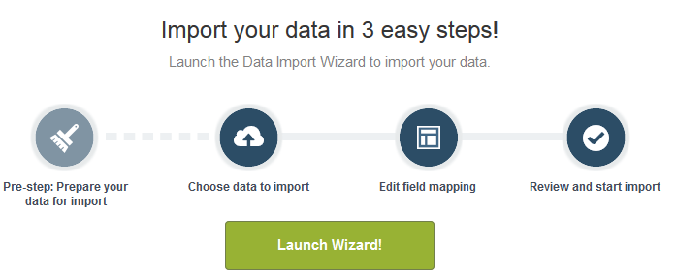
b) Data Import Wizard
Helps in importing accounts, leads, solutions, custom objects, and contacts.
Easy to use and self explanatory data import wizard.
Insert and Delete operations not possible.
Duplicate data can be skipped.
All fields can be individually mapped.

Slide 17
Data Loader vs Import Wizard
Use the Data Loader when –
You need to load beyond 50,000 and up to 5,000,000 records at a time.
You need to load Objects not yet supported by Import wizard.
Schedule regular data loads such as nightly jobs.
Export data for backup purposes.
Use the Import Wizard when –
You need to load below 50000 records.
Objects that you choose to import are supported by Import Wizard – Standard and Custom.
Prevent duplicate records by uploading records according to account name and site, contact email address, or lead email address.

Slide 18
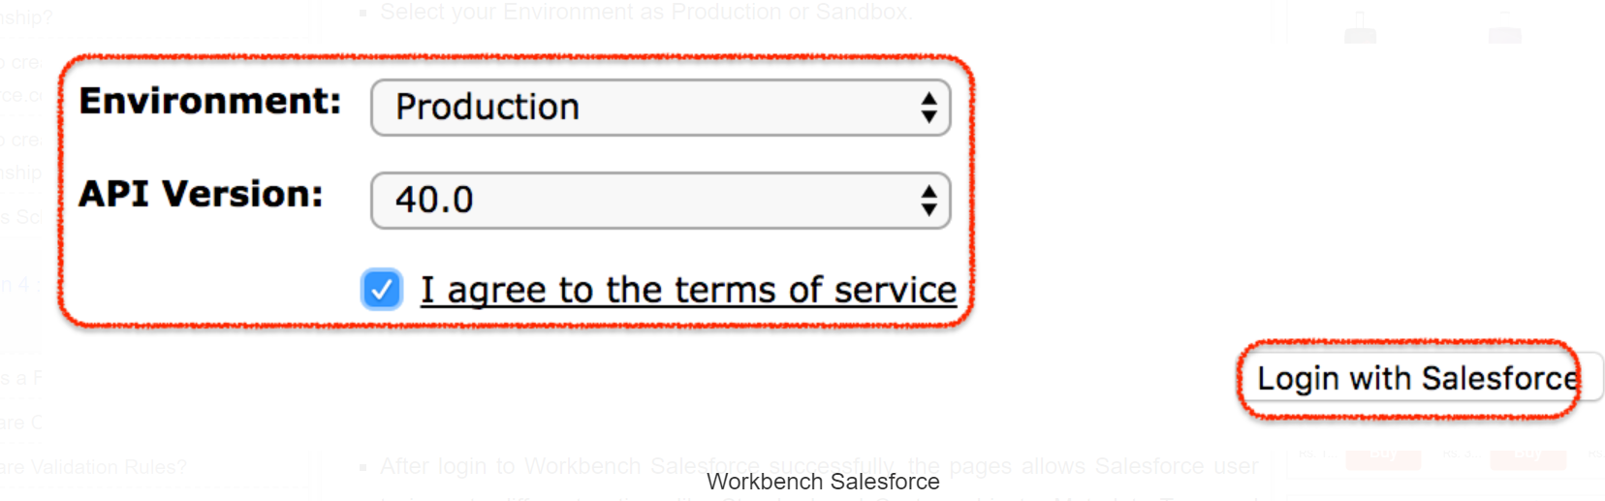
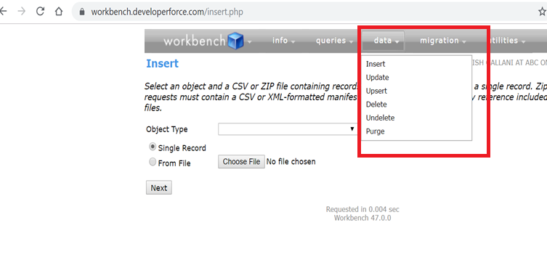
c) Salesforce Workbench
Workbench is a powerful, web-based suite of tools designed for administrators and developers to interact with Salesforce.com organizations.
Using Salesforce Workbench, administrators and developers can quick view their organization’s data, Data Loading, can perform SOQL Query, SOSL search, session settings, test, deploy and troubleshoot their own application.
Allows users to describe, query, manipulate, and migrate data.
Insert , Update ,delete , upsert , undelete and purge operations are available.

Slide 19
Best Practices – Salesforce Data Migration
The factors that need to be considered during data migration may vary depending on the complexity of your source data. However, for any data set, you can avoid having to constantly go back and forth to make sure all data is imported by following the standard protocol of planning, migrating and testing. While these steps are absolutely essential, it is equally important to avoid the following mistakes:
Planning without involving stakeholders .
Importing related Custom Objects in Random Order.
Importing large data in the Production Environment in the first go.
Mapping irrelevant data fields .
Forgetting to review active workflows and triggers.
Not testing in the end.

Slide 20
THANK YOU
About Deloitte Deloitte refers to one or more of Deloitte Touche Tohmatsu Limited, a UK private company limited by guarantee (“DTTL”), its network of member firms, and their related entities. DTTL and each of its member firms are legally separate and independent entities. DTTL (also referred to as “Deloitte Global”) does not provide services to clients. In the United States, Deloitte refers to one or more of the US member firms of DTTL, their related entities that operate using the “Deloitte” name in the United States and their respective affiliates. Certain services may not be available to attest clients under the rules and regulations of public accounting. Please see www.deloitte.com/about to learn more about our global network of member firms.. Copyright © 2019 Deloitte Development LLC. All rights reserved.

